Slide 1
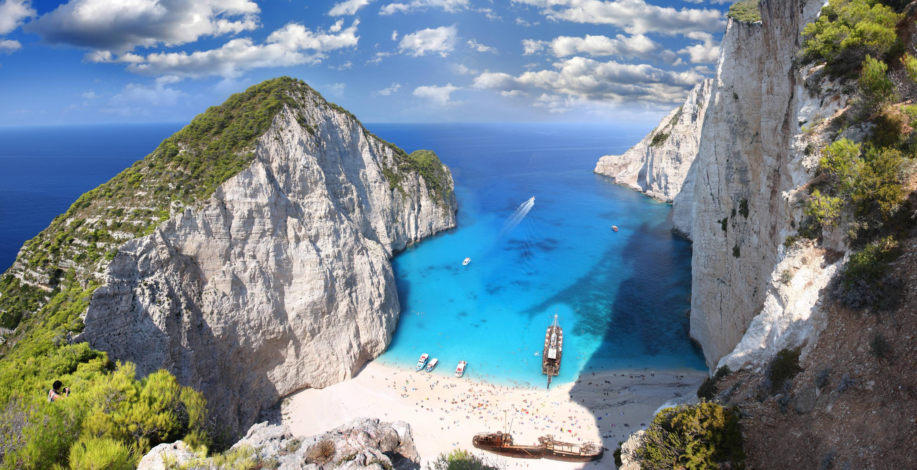
welcome
to Lecture 2

Slide 2
Computation and the Brain

Slide 3
First: What happened last Wednesday

Slide 4
COMPUTER | THE BRAIN
Inorganic | Alive
Exact | Error prone
70 – 7,000,000 Watts | 20 Watts
Chess, Go, Jeopardy | Survival, creativity, dreams
10¹⁰ ⁻⁻ ¹⁸ operations/s 1 – 40,000 processors | 50 operations/s, 10¹¹ components
Connects to others | If in the mood
Was designed | Has evolved
Cool machine | Rather emotional
Behavior is deliberately programmed | Behavior is emergent

Slide 5
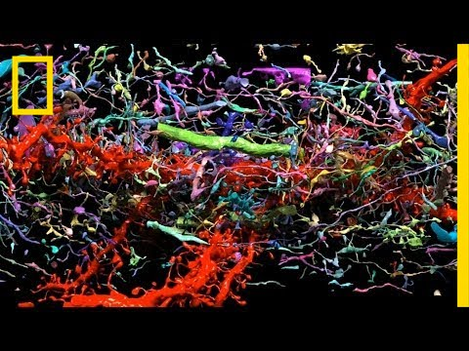
Connectomexplorer
See the Simons talk by Lichtman

Slide 6
Administrivia
The nature of the course
Homework
Participation and attendance
The project
The wait list

Slide 7
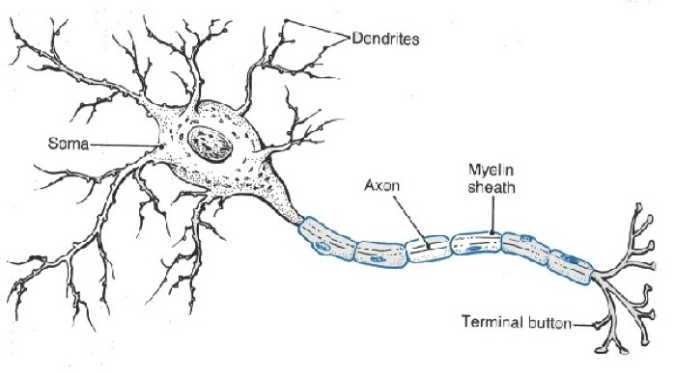
The Neuron
soma
dendrite
axon
cone
myeline
boutons and spines
membrane and its potential (-70 mV in steady state)
many kinds

Slide 8
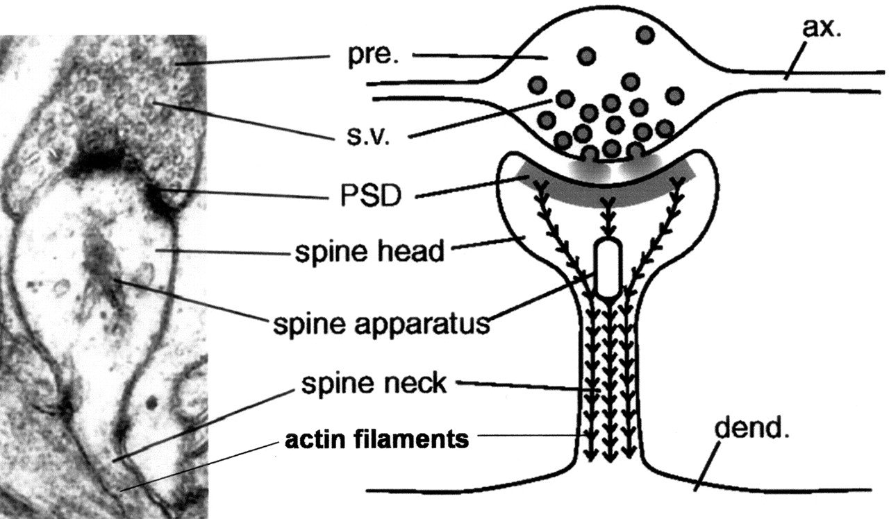
The synapse
Bouton
Spine
Cleft
Synaptic weight and plasticity

Slide 9
Neurotransmitters: many kinds
Amino acids: glutamate, aspartate, D-serine, γ-aminobutyric acid (GABA), glycine
Gasotransmitters: nitric oxide (NO), carbon monoxide (CO), hydrogen sulfide (H₂S)
Monoamines: dopamine (DA), norepinephrine (noradrenaline; NE, NA), epinephrine (adrenaline), histamine, serotonin (SER, 5-HT)
Trace amines: phenethylamine, N-methylphenethylamine, tyramine, 3-iodothyronamine, octopamine, tryptamine, etc.
Peptides: somatostatin, substance P, cocaine and amphetamine regulated transcript, opioid peptides^{[11]}
Purines: adenosine triphosphate (ATP), adenosine
Others: acetylcholine (ACh), anandamide, etc.

Slide 10
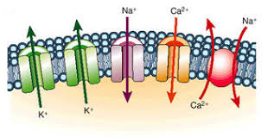
Ion channels
Voltage gated, or
Ligand gated (controlled by other neurotransmitters…)
Glu lets X⁺ in: excitatory
GABA lets X⁻ in: inhibitory
Ions define the membrane potential of the neuron

Slide 11
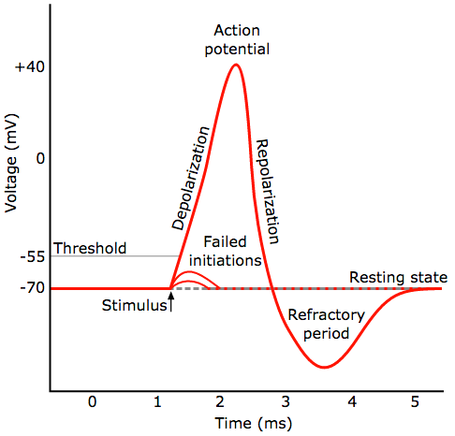
The spike, how?
Resting potential = K⁺ balance
Accumulation of excitatory input raises potential
When threshold passed, voltage-gated influx of Na⁺ : depolarization
1ms later, a voltage-gated massive outflux of K⁺: back to resting potential and beyond: hyperpolarization
Refractory period ~1ms

Slide 12
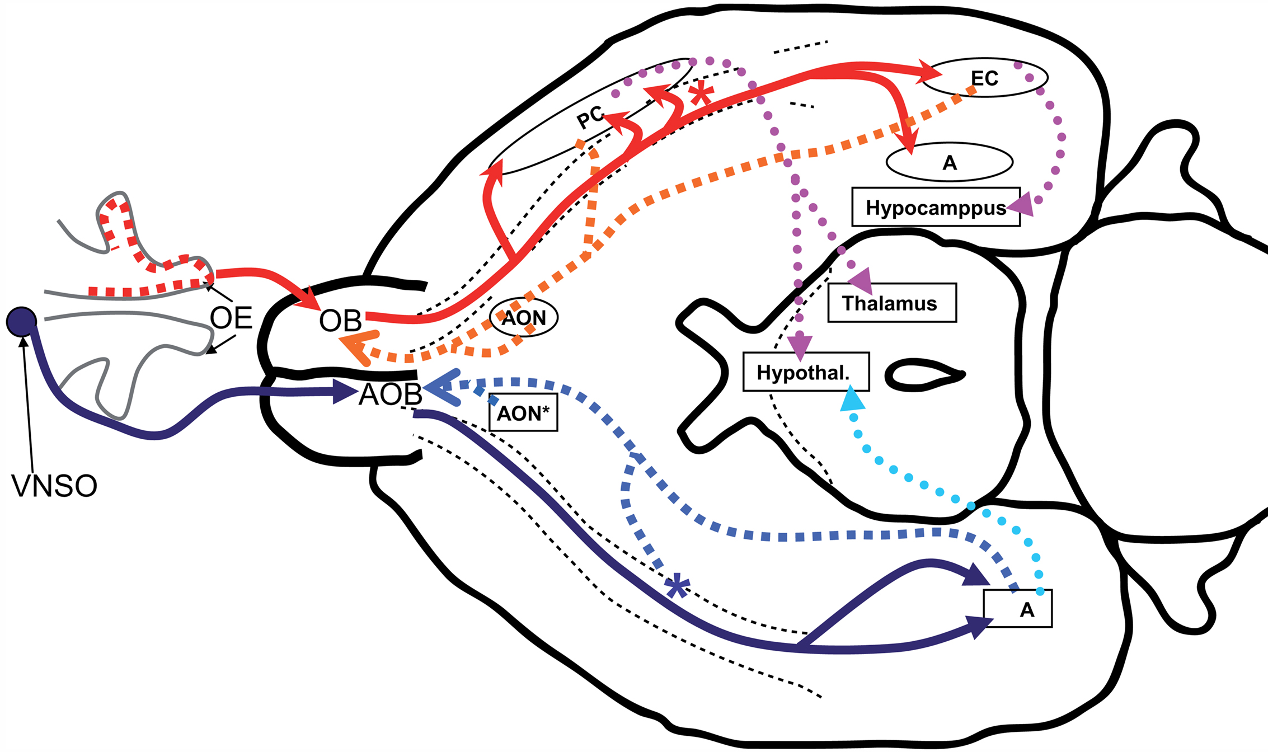
Olfaction*
* Will not discuss further, possible topic

Slide 13
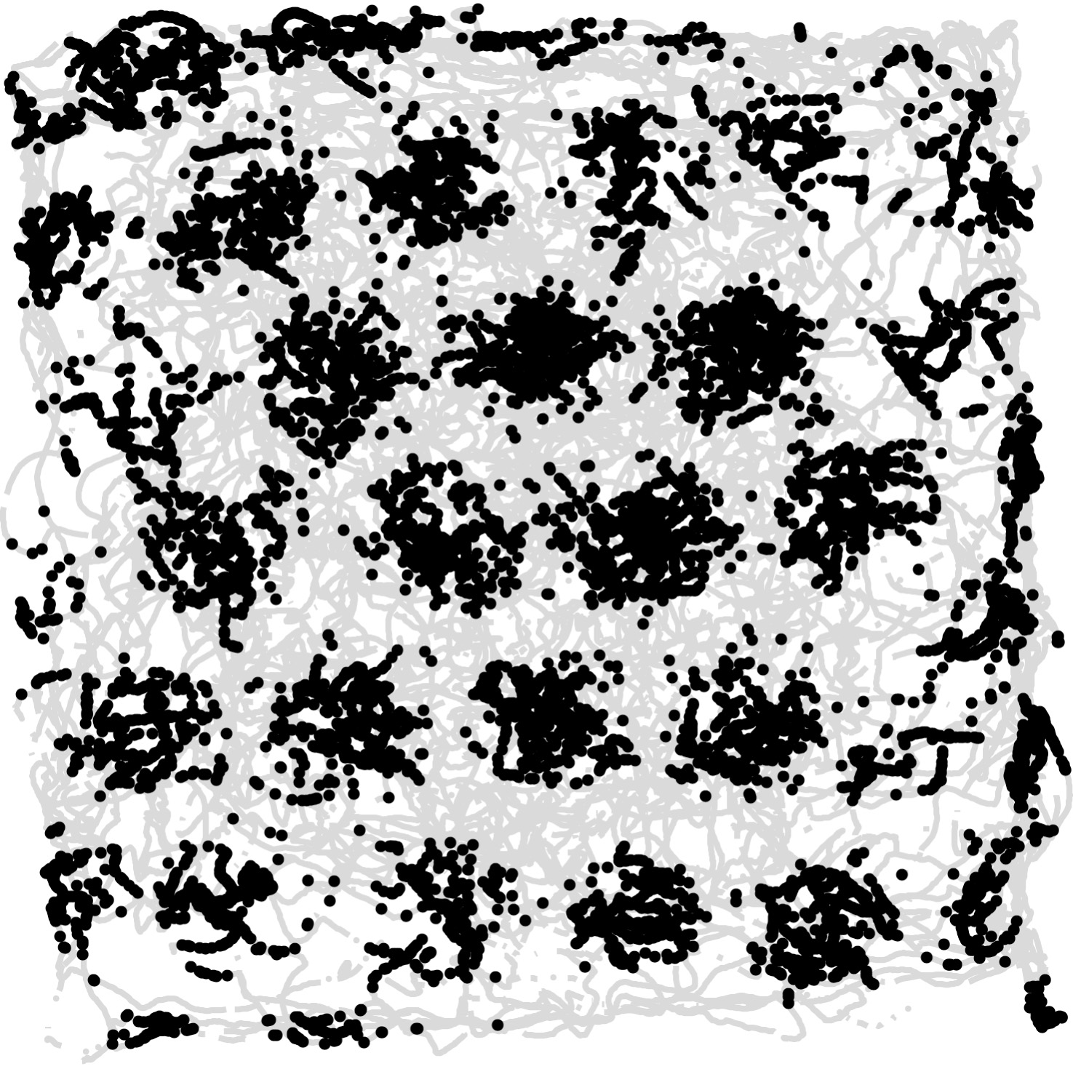
Grid and place cells*
Tuning curve of a grid cell
A neuron in the entorhinal cortex that fires when the animal is in any one of the nodes of a triangular grid
The movie:
https://www.youtube.com/watch?v=i9GiLBXWAHIons in
* Will not discuss much further, possible topic

Slide 14
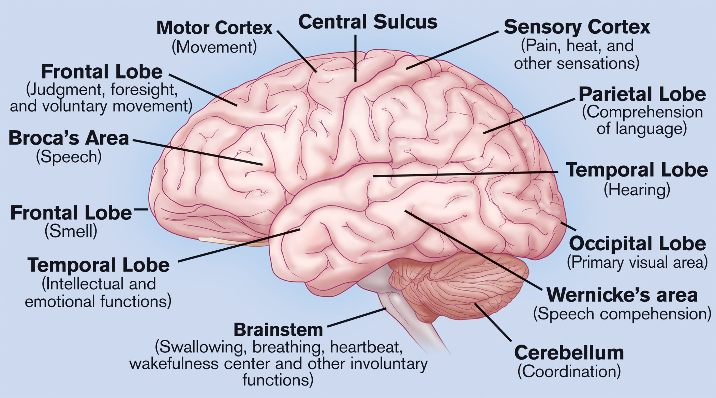
parts of the brain

Slide 15
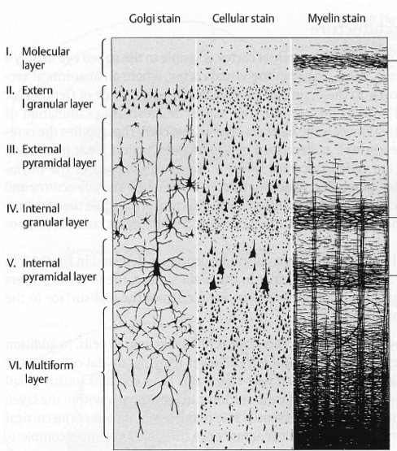
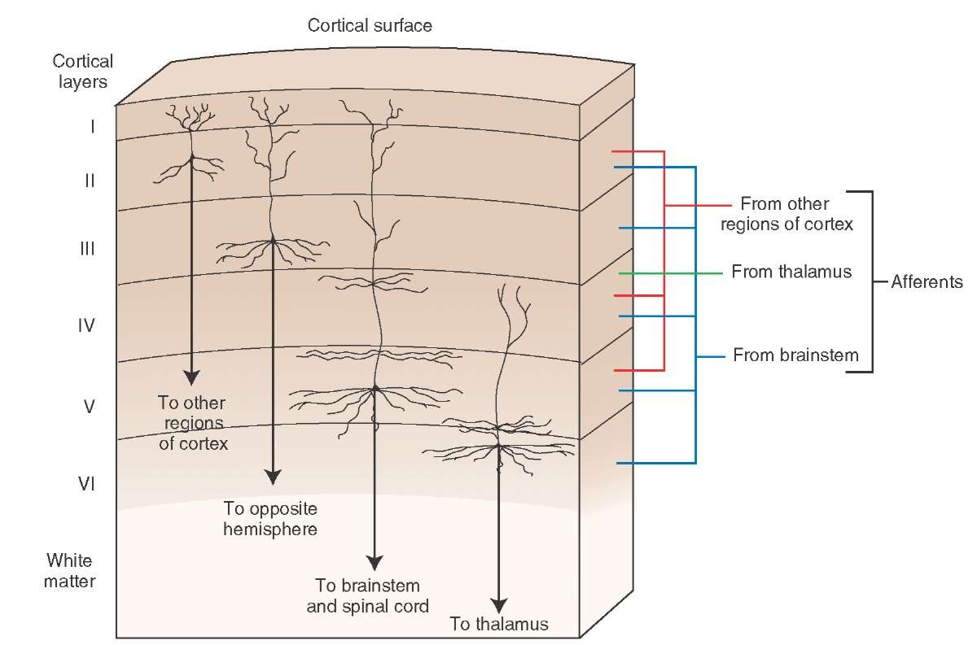
(Cerebral) Cortex: the engine
1.5 mm
2500 cm²
six layers
20B neurons

Slide 16
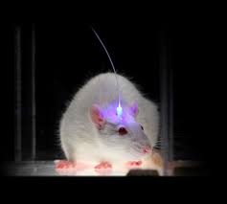
Recording techniques: single unit, fMRI, EEG, ECoG
Forgot to mention the hottest:
Optogenetics – Ca⁺ imaging

Slide 17
Our topics:
Today (continued to next time): Vision, CNN, PCA, gradient descent
Synapses and connectomics
Learning and plasticity
Memory, hippocampus, place cells
Whole brain computational models
Motion and decisions
Brain oscillations
Reinforcement learning
Natural language
Assemblies of neurons
On evolution and development

Slide 18
Today: Vision
The eye
The visual cortex
The Hubel - Wiesel cat
Gradient descent
Convolutional neural networks
Supervised vs unsupervised learning
PCA
The Olshausen-Field paper

Slide 19
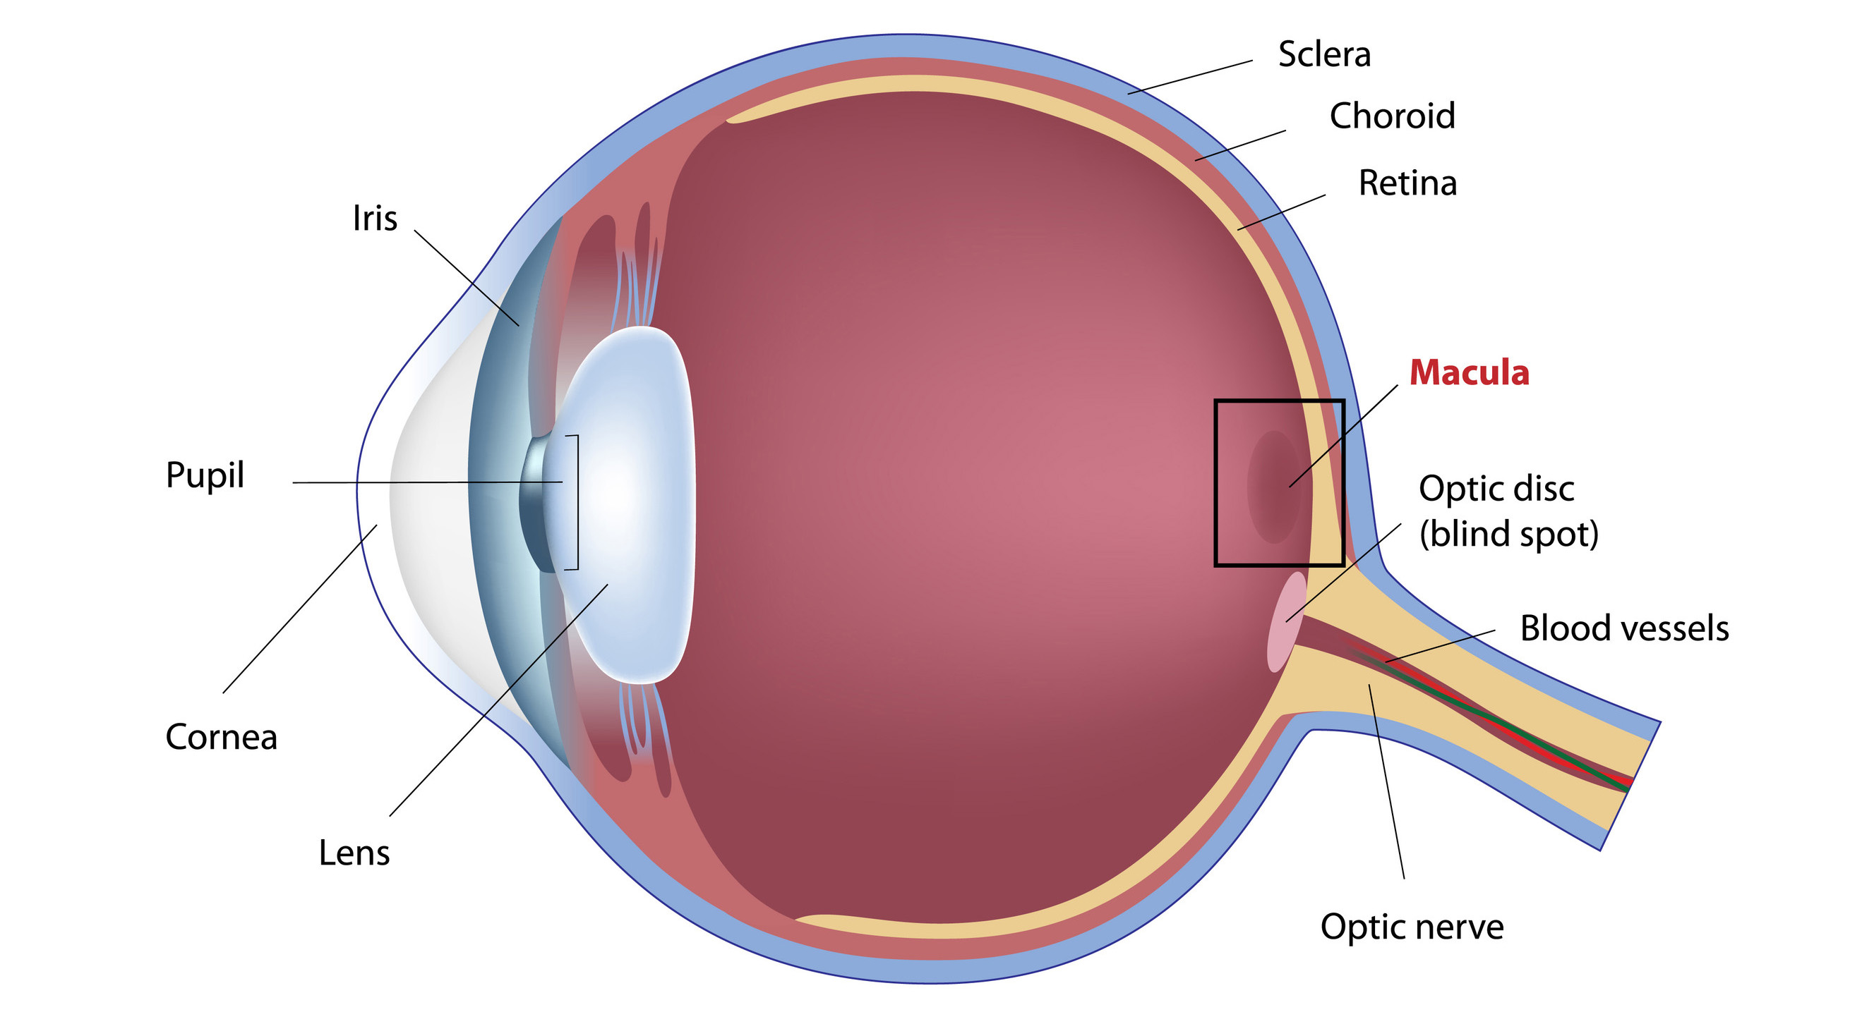

Slide 20
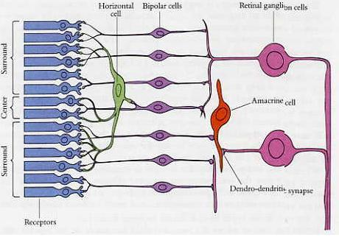

Slide 21
How do we know all this?
1967 Nobel prize for the physiology and chemistry of vision: George Wald, Ragnar Granit, and Haldan Keffer Hartline

Slide 22
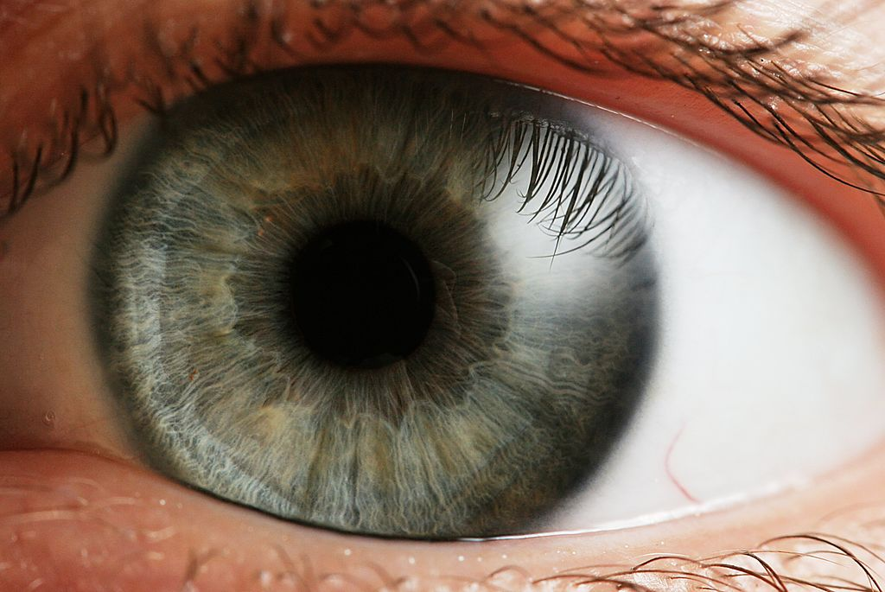
“To suppose that the eye with all its inimitable contrivances for adjusting the focus to different distances, for admitting different amounts of light, and for the correction of spherical and chromatic aberration, could have been formed by natural selection, seems, I freely confess, absurd in the highest degree”
Charles Darwin The Origin of Species 1859.”

Slide 23
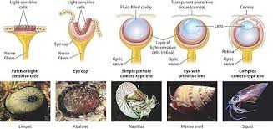
Absurd things do happen…

Slide 24
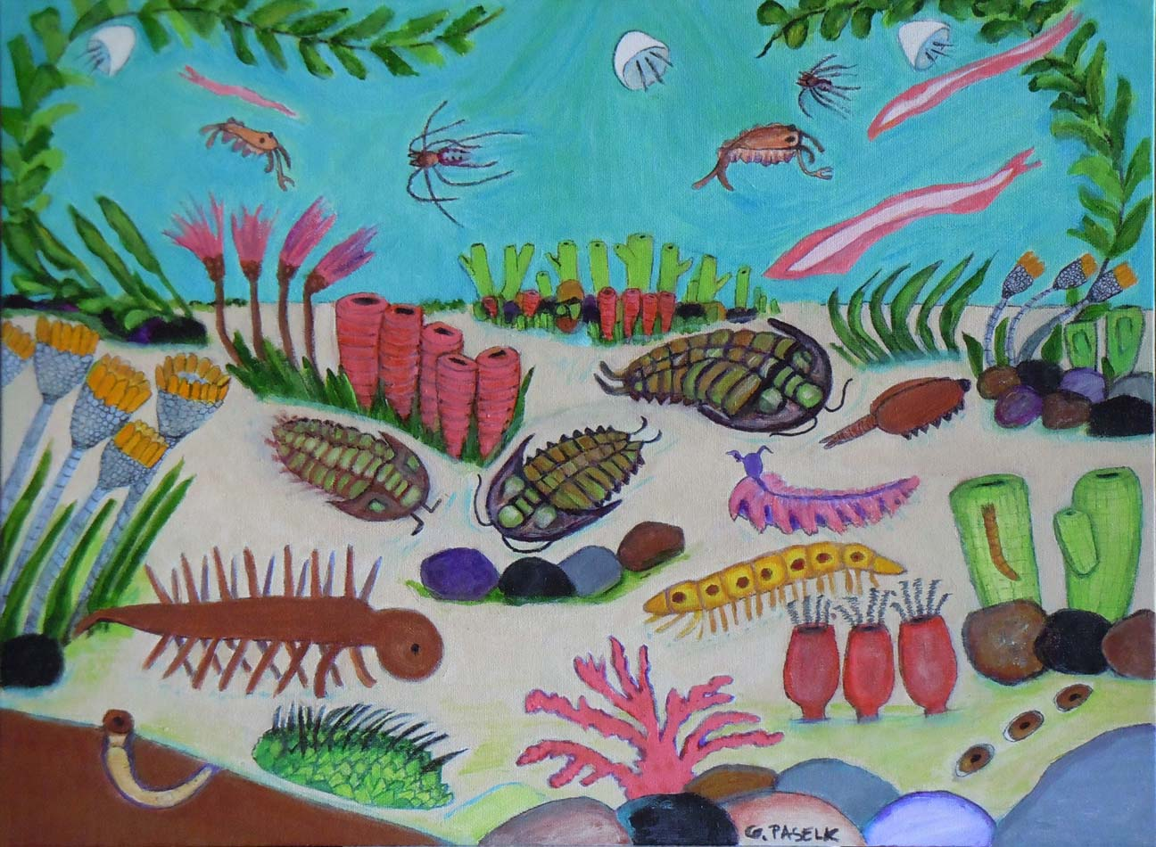
Early Cambrian (530 Mya): vision + locomotion = acceleration

Slide 25
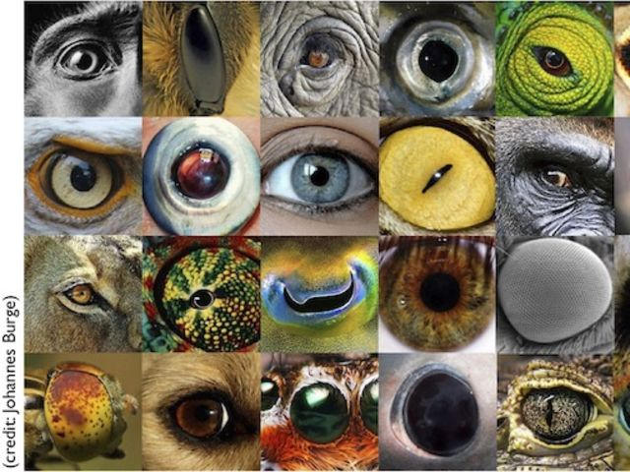
Many independent discoveries/early branches

Slide 26
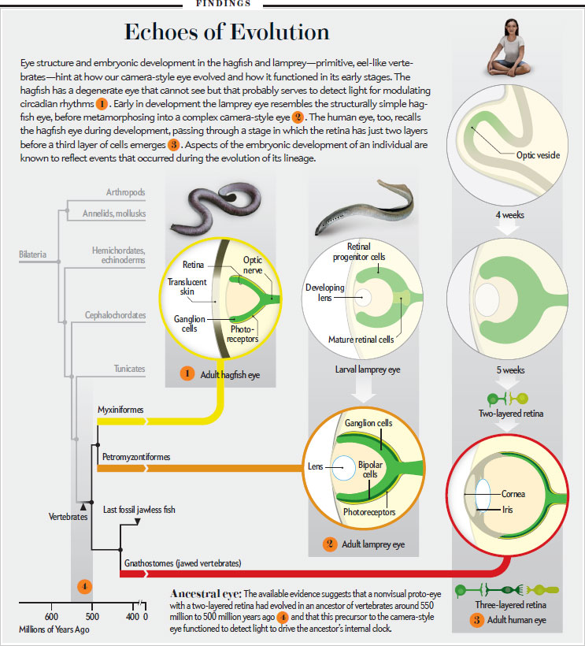
One of them is the vertebrate eye…

Slide 27
So, what happens
after
the retinal ganglia?

Slide 28
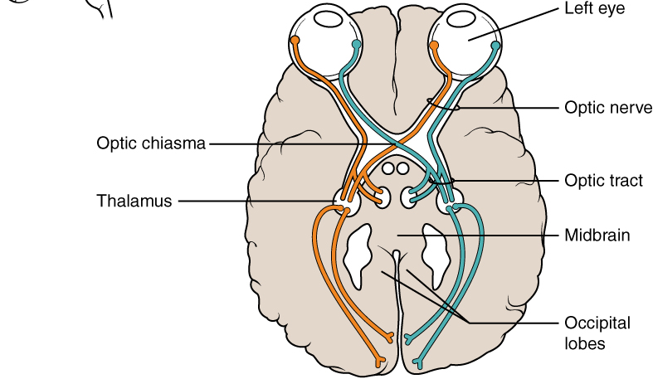
The chiasm

Slide 29
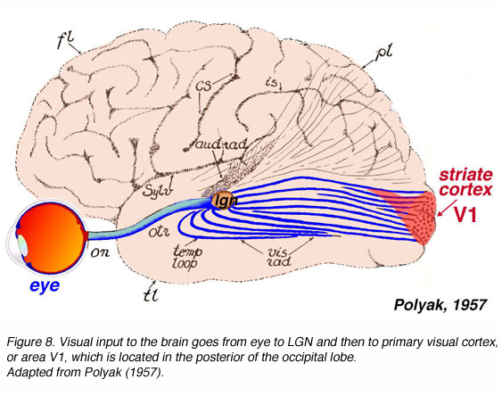
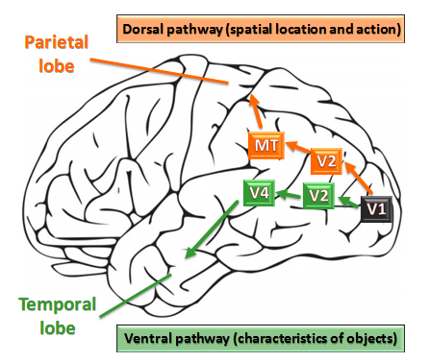
The archetypical deep net

Slide 30
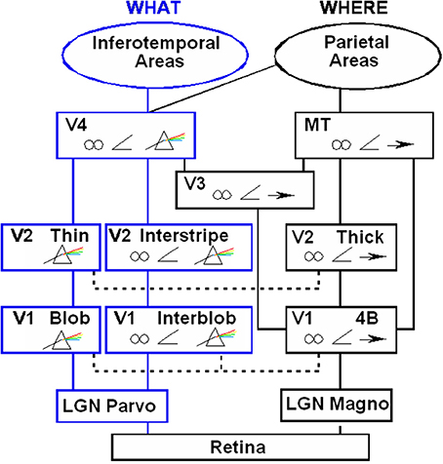
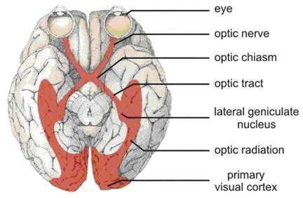
The paths
Symbols for:
Binocular
Angle
Color
Motion
Areas within V1

Slide 31
Total time for the path: 0.15s

Slide 32
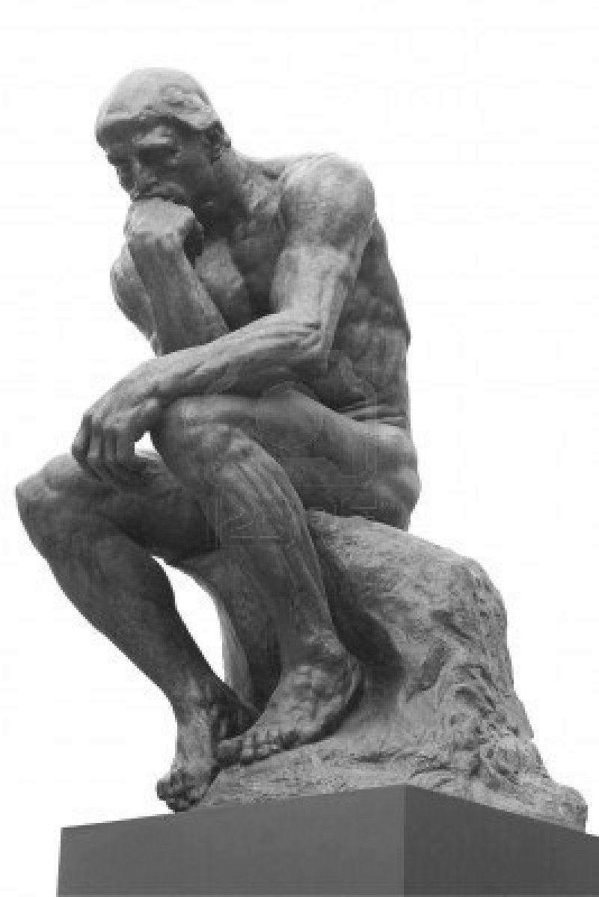
Total time for the path: 150 ms
Q: Too fast? Too slow?
What is the depth of the network?
Total axon distance traveled ~10ms
Each neuron firing every 20ms
Human reaction to visual stimulus:
250ms
Audio: 170ms. Touch: 150ms
btw, Break: 1,500 ms

Slide 33
Not the Thinker!
https://www.dailymotion.com/video/x278zke

Slide 34
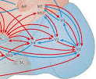
Back to the path: not so simple…
There are many
feedback axons!
(see Jeff Hawkins
“On Intelligence”)

Slide 35
The path: not so simple….
All upward links also go through the thalamus!
(see Simons talk by Murray Sherman)

Slide 36
But what does this circuit compute?

Slide 37
The Hubel and Wiesel experiment (1959)
Recorded from neurons in the visual cortex (and LGN) of an immobilized, awake, sedated, locally anesthetized cat
Showed various visual stimuli
Changed a stimulus parameter, such as angle or horizontal offset
Calculated firing rate, ultimately the receptive field, of each neuron (~ the max of the tuning curve) as a function of the parameter(s)
https://www.youtube.com/watch?v=8VdFf3egwfg

Slide 39
What Hubel and Wiesel did
Pioneered the experimental methodology (1959)
Receptive fields beyond the retina (cf. Hartline 1940)
The importance of edge detection (1959)
Reflected on the experiment, conjectured how edges can be detected by a hierarchical neural circuit (1962)
Nobel (1980)

Slide 40
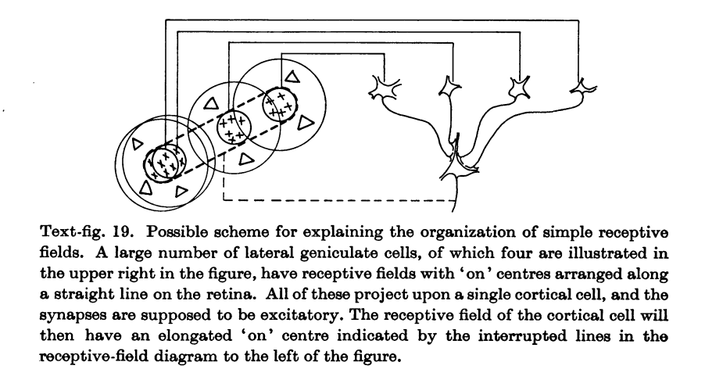
The Hubel – Wiesel conjecture: simple cells

Slide 41
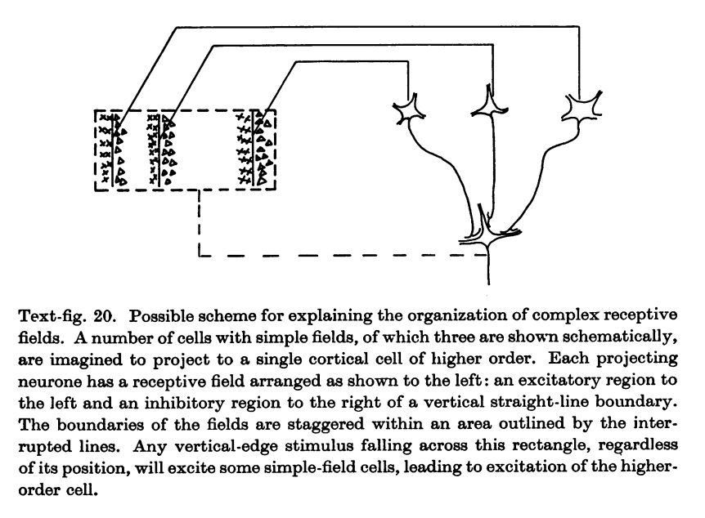
The Hubel – Wiesel conjecture: complex cells

Slide 42
Wow!

Slide 43
Incidentally: brief history of the killer discussion section maneuver
Crick and Watson, 1953 → Nobel 1962
"It did not escape our attention that a certain connection that we immediately postulated offers a possible mechanism for copying genetic material.”
Hubel and Wiesel 1962 → Nobel 1981
Abel and Buck 1991 → Nobel 2006

Slide 44
Recall the study of neurons in CS
1944: McCulloch – Pitts neuron
1957: The Rosenblatt perceptron
"the embryo of an electronic computer that the Navy expects will be able to walk, talk, see, write, reproduce itself and be conscious of its existence.” NYT 1957
1960s: XOR and the Minsky – Papert perceptron (1972)
The first AI winter
1975 K. Fukushima: the Cognitron

Slide 45
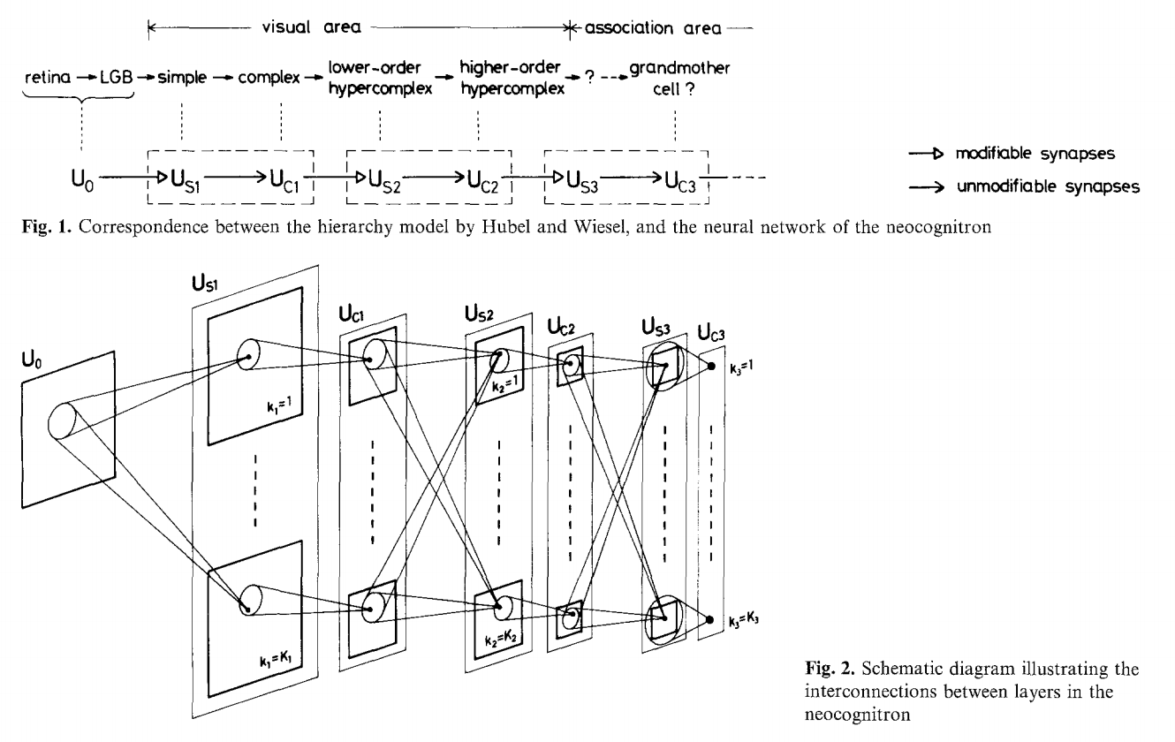
K Fukushima 1980: The Neocognitron
Explicitly inspired by
Hubel and Wiesel
”unsupervised learning”
of weights

Slide 47
But how are the weights learned?
”The unreasonable effectiveness of gradient descent in learning”
cf: The unreasonable effectiveness of mathematics in the natural sciences by Eugene Wigner

Slide 48
Gradient descent
To approximate the minimum of a differentiable function f: R^{d} → R
Set t = 0, and set x⁰ to some initial point
Repeat
calculate the gradient ∇f(x^{t})
and the ``learning rate’’ 𝝰_{t}
x^{t+1} = x^{t} - 𝝰_{t} ∇f(x^{t})
Until termination condition (typically, |x^{t+1} – x^{t}| very small)
This is the science/
dark art of the matter

Slide 49
What is known about gradient descent
Theorem: If f is a strictly convex quadratic function
x^{T}A x + b x, and L is the largest eigenvalue of A, taking 𝝰_{t} = 1/L guarantees logarithmic convergence (the distance from the optimum decreases exponentially fast).
Theorem: Ditto is f is a general strictly convex function, and L is an upper bound on the Hessian’s eigenvalues.
Theorem: If f is not convex, then no convergence can be guaranteed whatsoever
It doesn’t matter!

Slide 50
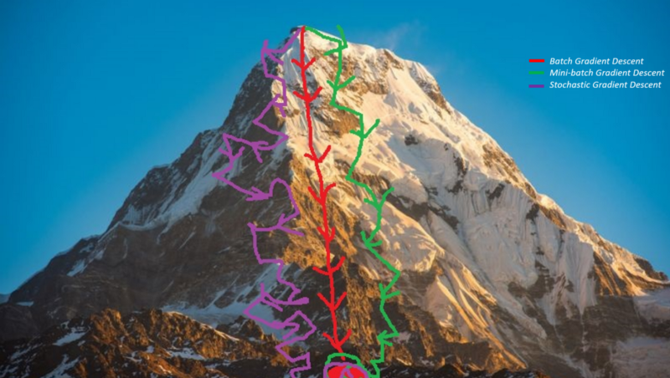

Slide 51
Stochastic gradient descent
What if f(x) = ∑_{k} g(x) is the sum of millions of functions?
(The loss function of a NN is an example.)
Computing the gradient takes millions of steps
Except if you sample it!
At every step you add the gradients of the next few functions (and scale up)

Slide 52
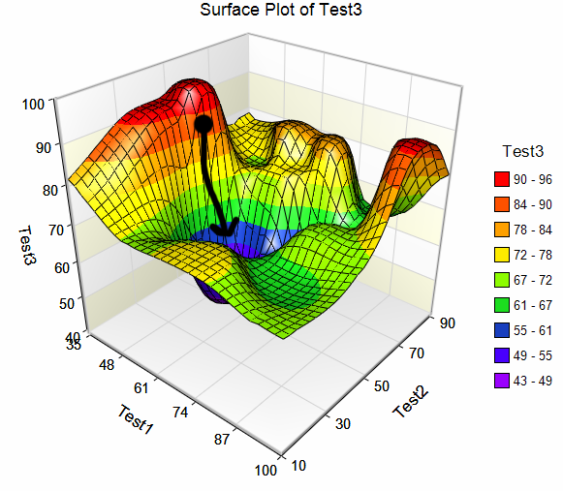

Slide 53

Btw: Can you visualize 10-dimensional data?
The volume of the inscribed sphere
1-d 1.00…
2-d 0.79…
3-d 0.52…
4-d 0.31…
5-d 0.16…
…
10-d 0.002…

